Slide 1
Agile and Scrum

Slide 2
Agenda
What is Agile?
What is Scrum?
What is ALM?

Slide 3
1. What is Agile?
Agile software development– Agile
Agile is a philosophy of software development
Agile is focused on quick responses to change and continuous development

Slide 4
Agile manifesto
Agile manifesto:
Individuals and interactions over processes and tools
Working software over comprehensive documentation
Customer collaboration over contract negotiation
Responding to change over following a plan

Slide 5
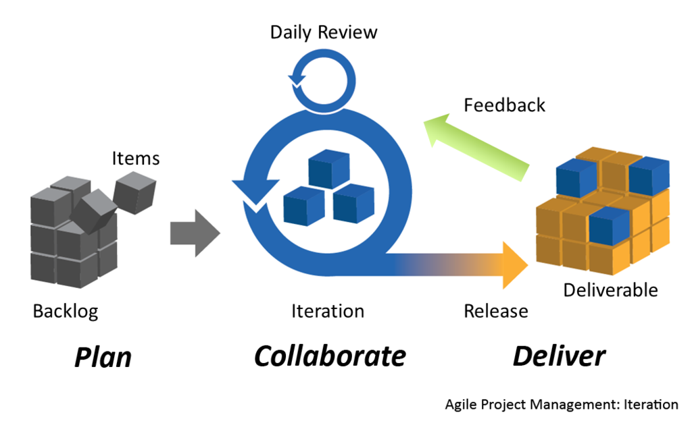
Agile modeling

Slide 6
Agile practices
Backlogs (Product requirement)
User story
Iterative and incremental development (IID)
test-driven development (TDD)
Timeboxing
Scrum meetings (Sprint planning, Daily scrum, Sprint review and retrospective)
Cross-functional team
Velocity tracking
Continuous integration
…

Slide 7
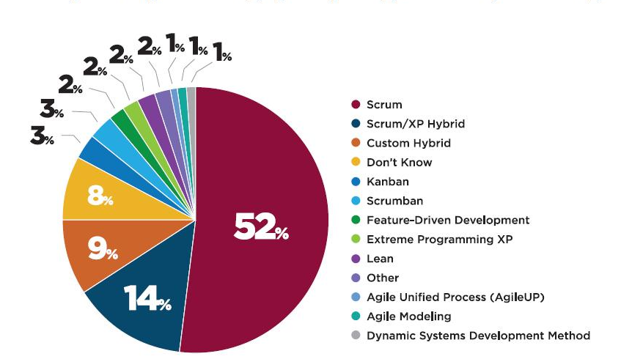
Agile methods
Apply several practices into an framework to maximize the productivity and call it as agile methods

Slide 8
2. What is Scrum?
The collection of Agile practices
Scrum is an iterative and incremental agile framework

Slide 9
Elements of Scrum
Product Owner
Scrum Master
Team Member
Iteration Planning
Daily Scrum
Iteration Review
Iteration Retro
Product Backlog
Sprint (Iteration)
Burn down Charts
Release plan
Scrum Team
Scrum Events
Scrum Artifacts

Slide 10
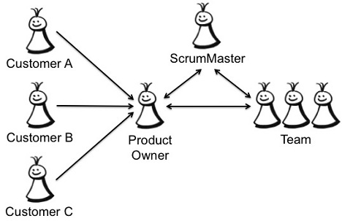
Scrum Team
The Scrum Team consists of:

Slide 11
Product Owner
The Product Owner is the person responsible for managing the Product Backlog
In charge of collaborating with stakeholders to define requirements
In charge of evaluating the output of team

Slide 12
Scrum Master
Having deeply understanding of Scrum
Making sure that team follow Scrum’s core value, practices and rules

Slide 13
Team Member
In charge of converting product backlog items into shippable function

Slide 14
Product Backlog
Product Backlog is defined as User Story
Product Backlog sizing and effort estimating is done at the User Story level

Slide 15
User Story
A User Story is composed of 3 aspects:
Written description of the Story
Conversation about the Story (Document or discussion)
Acceptance criteria which can be used to determine when a story is “complete”

Slide 16
User Story
A User Story includes:
Title: As a <role>, I want <goal/desire> so that <benefit>.
Example: As a user I would like one installation for PEToolkit that is combined with the EDM for ease of use

Slide 17
User Story
A User Story includes:
Description (Describe more details of the User Story)
Rank/Priority (define by PO base on reality situation)
Complexity/Size (define by PO base on the function or feature investigation)
Business Value (define by PO)

Slide 18
User Story
A User Story includes:
Tasks (Dev tasks and QA tasks)
Test cases
Bugs
Changesets

Slide 19
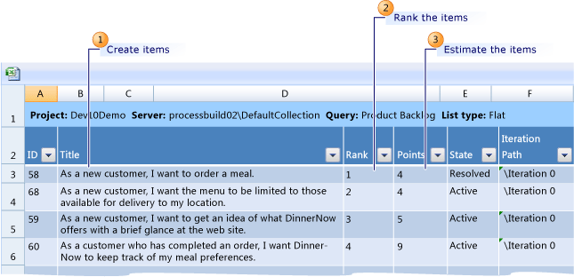
User Story

Slide 20
Release Planning
Purpose is to establish a plan to release number of completed product backlog items
Each iteration creates an increment of the Product, beginning with the most valuable
When enough increment of product are created, it’s ready to be released
Purpose:
To establish a plan and goals that the Scrum Teams and the rest of organization can understand and communicate.
The release plan establishes:
The overall goal of the release
Prioritization of the Product Backlog

Slide 21
Sprint (Iteration)
An Iteration is a “Time-Boxed” which has duration between 2 – 4 weeks
In this “Time-Boxed”, tasks are defined to achieve the Iteration Goals
Tasks and Goals of a Iteration (once started) remains fixed to ensure the team commitments are achieved.

Slide 22
Sprint (Iteration)
The Iteration “Life-Cycle” consists of:
Iteration Planning
Daily Scrum
Iteration Review
Iteration Retrospective

Slide 23
Iteration Planning
Iteration Planning consists of two meetings:
The What? At this meeting, what will be done in this Iteration is decided. 4 hours time-box.
The How? At this meeting, the team figures out how it is going to build this functionality into a product increment during the Iteration. 4 hours time-box.

Slide 24
Iteration Planning
The “What?” meeting:
Input: User Stories, latest increment of Product, team’s capacity/past performance.
The PO presents the top priority User Stories to the team
Team works together to commit to what functionality is to be developed during the next Iteration

Slide 25
Iteration Planning
The “How?” meeting:
Input: Prioritized User Stories
Team figures out how to turn the User Stories into functionality of product increment
Team starts by designing the tasks.

Slide 26
Daily Scrum
When the iteration started, team meets daily in a meeting (daily scrum meeting) to answers three questions:
What have you done since yesterday?
What are you planning to do today?
Any impediments or blocking issue?

Slide 27
Iteration Review
The iteration review meeting is conducted at the end each iteration
In this meeting, team present (a demo) the completed work or the working functionality to the stakeholders
Time-box is 4 hours

Slide 28
Iteration Retrospective
The iteration Retrospective meeting is conducted after the iteration review meeting but prior to starting the next iteration
A review of how the last iteration conducted:
What went well: continue to do that
What went wrong: stop doing that
What should we do: start doing that

Slide 29
Burndown Chart
A chart to:
Track daily progress against iteration commitment
On Total estimated task effort, what have been done?
What is left to do and the amount of time left?
Predict the outcome of the project by predicting the future velocity of the iterations

Slide 30
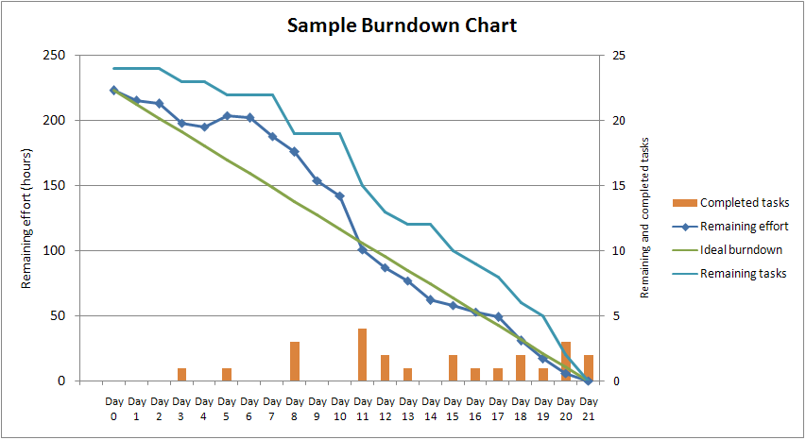
Burndown Chart

Slide 31
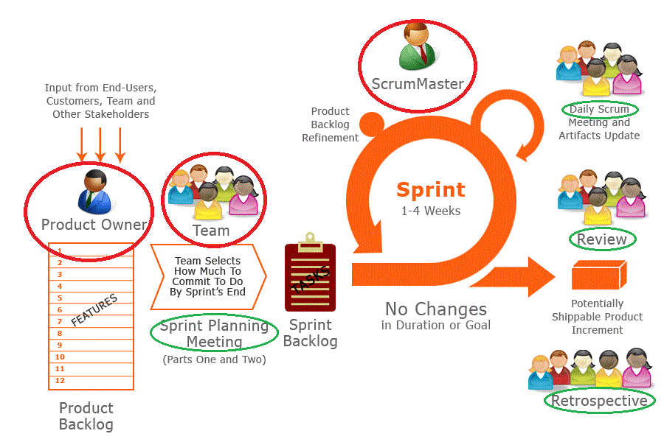
How to run Scrum?

Slide 32
The core value of Scrum
Transparency:
All information of the progress must be visible to those responsible for the outcome
Inspection
Scrum artifacts and progress must be inspected frequently to detect problem or obstacles
Adaptation
If the inspection observes that the artifacts and progress go outside acceptable limits. The process or the material being processed must be adjusted

Slide 33
3. What is ALM?
ALM = Application Lifecycle Management
It is one central location for the entire product organization to go, work, prioritize, focus, assign work, check status, run reports- everything.

Slide 34

What is ALM?
IDE: integrated development environment
Tools suites
IDE
Code Editor
Compiler
Source Control
Continuous Integration

Slide 35

What is ALM?
Tools suites
Testing
Requirements
Test Cases
Bugs
Automation

Slide 36

What is ALM?
Tools suites
Complete Development Lifecycle
Requirements
Test Cases
Bugs
Automation
Writing code
Source Control
QA Test Tools
Dev Test Tools

Slide 37
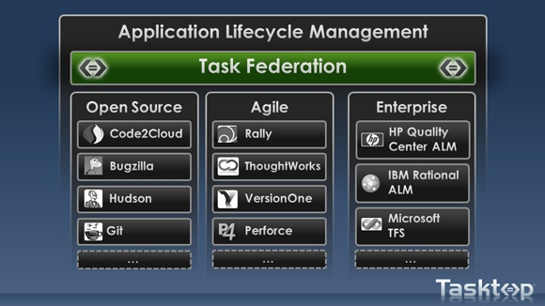
ALM
There are a wide variety of ALM solutions.

Slide 38
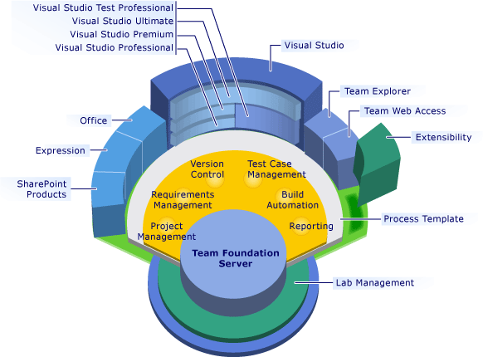
The Microsoft Solution

Slide 39
Conclusion
Flexibility in delivering high valuable production
Team maturing and adapting increase the productivity

Slide 40
THANK YOU

Slide 41
Sources
http://en.wikipedia.org/wiki/Agile_software_development
https://www.scrum.org/
http://en.wikipedia.org/wiki/Scrum_(development)

